Slide 1
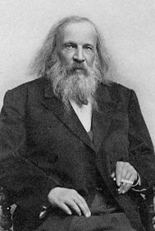

THE PERIODIC TABLE

Slide 2
BELL WORK
1. What is the charge on:
Electron
Proton
Neutron
Ion
2. Name a halogen and a metal that would be the:
smallest atom
most reactive
3. Draw the electron shell diagram for:

Slide 3
Riddle me an element!
You use me to write on papers. What am I?
I am in your kitchen pantry, waiting to wrap up some leftovers. What am I?
I am found in jewellery, but am not as expensive as other
metals. What am I?

Slide 4
Riddle me an element!
In the competition, I am the metal you want to win the most. What am I?
There are two of me in one water molecule. What am I?
Kids love me! I am often used to expand balloons and make them float. What am I?

Slide 5
Riddle me an element!
I am a very important metal that makes your bones grow healthy and strong, you find me in dairy products. What am I?
You put me in your swimming pool to keep it clean. What am I?
Without me, you’d die because you wouldn’t be able to breath! What am I?

Slide 6
Riddle me a group?
You can stretch me and hammer me into sheets
I conduct electricity and I conduct heat
What am I?

Slide 7
Riddle me a group!
I look like stairs between other groups in the periodic table
I am unmetallic but sometimes, to semi conduct electricity, I am able
What am I?

Slide 8
Riddle me a group!
I am a loner and I do not like to mingle
Its because none of my outer electrons are single
What am I?

Slide 9
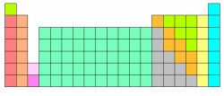
Periodic table trends and groups

Slide 10
TEST IS ON THURSDAY!
INDEPENDENT BOOK WORK:
3.2 pg 73
3.3 pg 75
3.4 pg 77
3.5 pg 79

Slide 11
EXIT TICKET
SPARE 5 MIN ON THE YELLOW TICKET
ATTEMPT THE QUESTIONS
PUT IT IN THE BOX BEFORE LEAVING CLASS

Slide 12
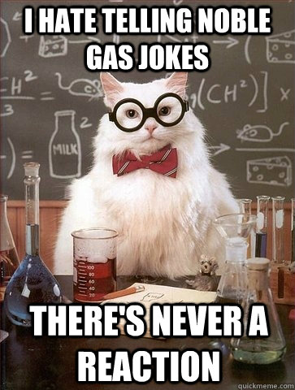
THANK YOU!

